Slide 1

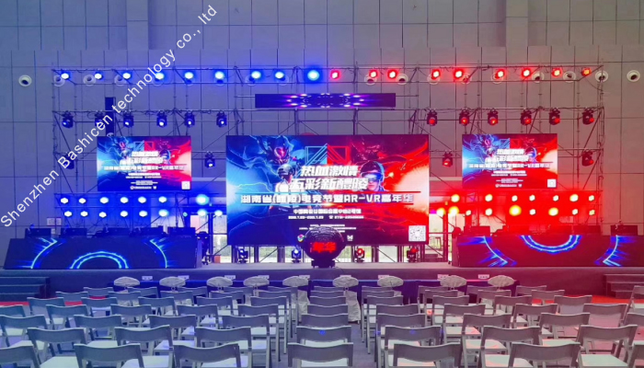
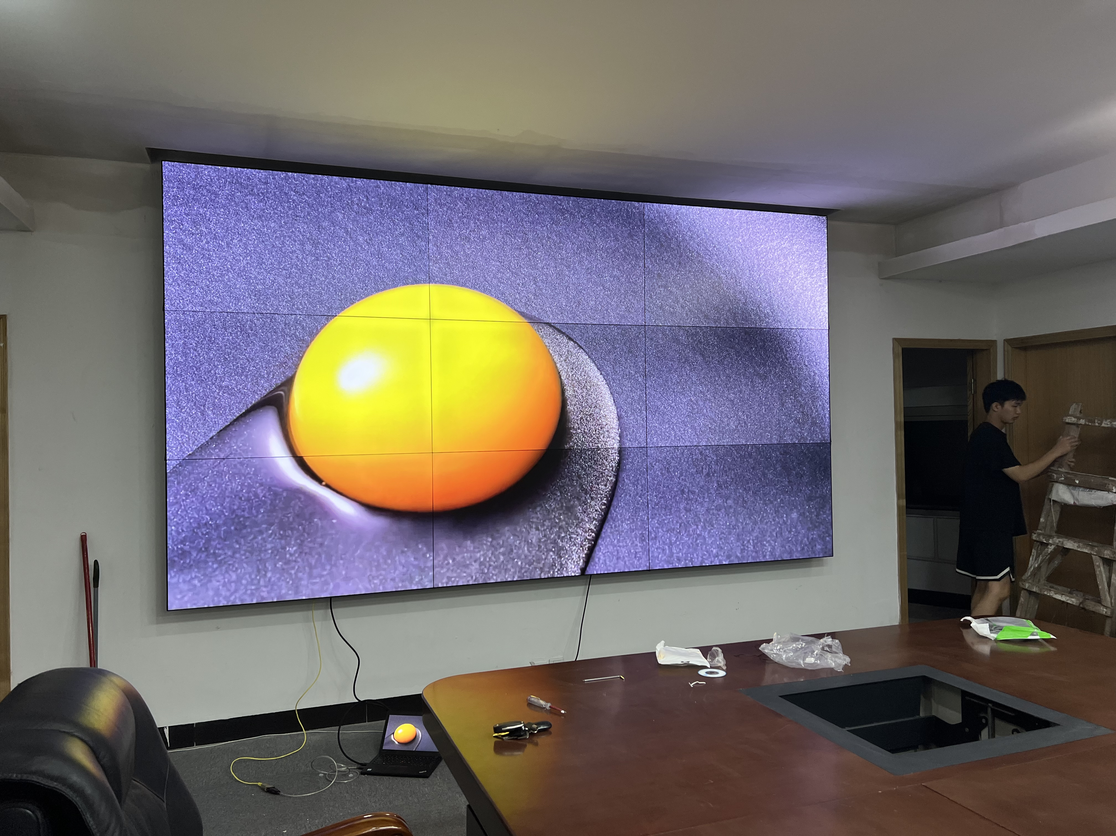
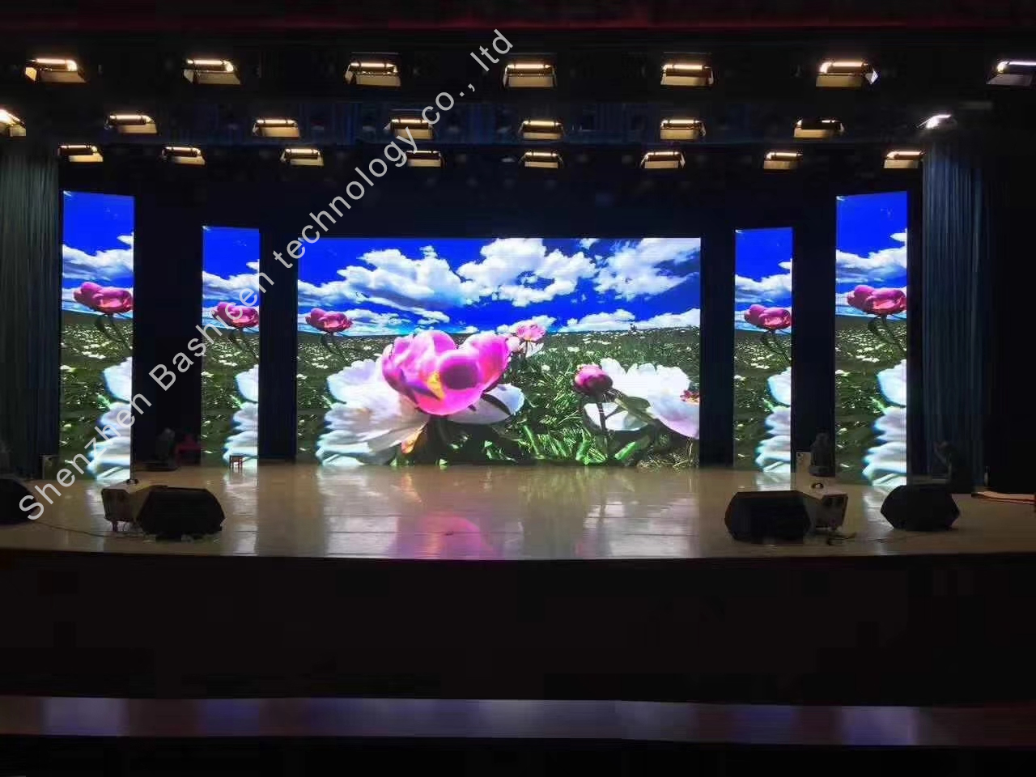
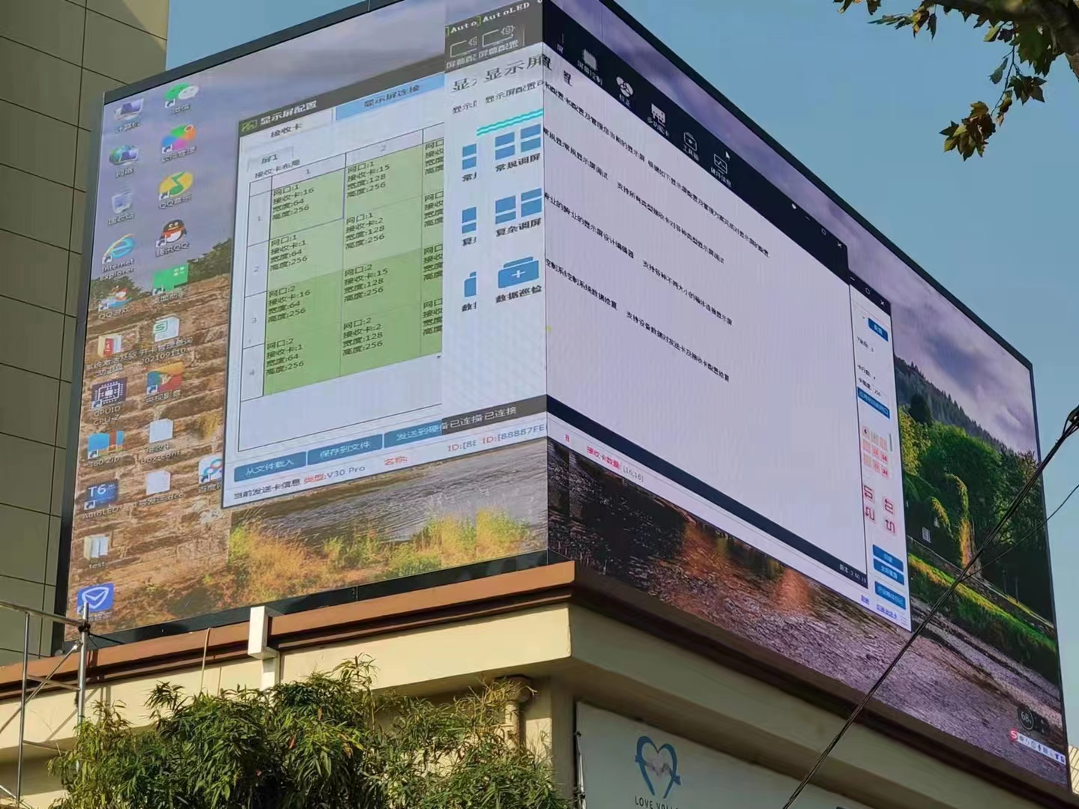
BAISHICEN
LED&LCD Manufacturer
LED&LCD DISPLAY CATALOG
Immersive experience display
with professional products
Further more information on LED&LCD Displays,
Please visit www.szbaisc.com
SHENZHEN BAISHICEN ELECTRONIC CO.,LTD
Address:402, Building A,1st Mashantou Park,Guang Ming, Shenzhen, 518107,China
Tel:+86 400 885 1938 Email: baisc168@qq.com
@2022 SHENZHEN BAISHICEN ELECTRONIC CO.,LTD All Rights Reserved.

Slide 2
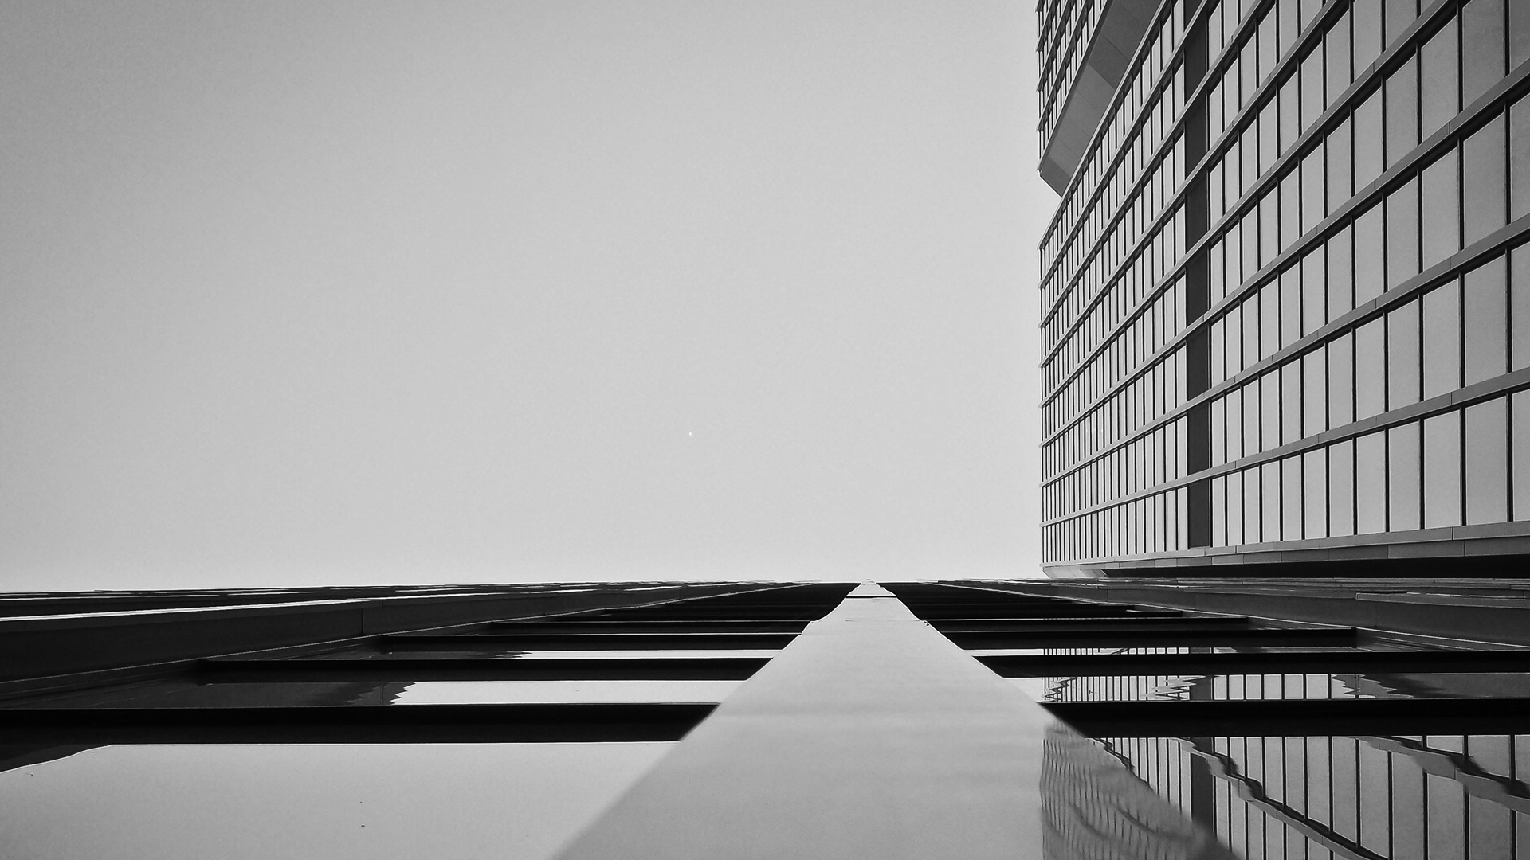
01
Company Profile
02
Certificates
CONTANTS
03
LED Display
04
LCD Display

Slide 3
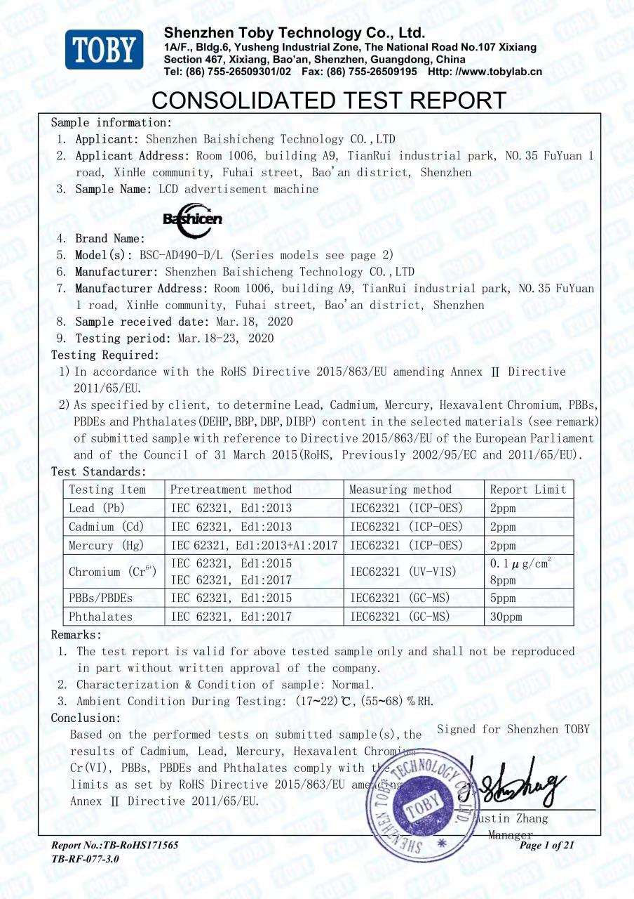
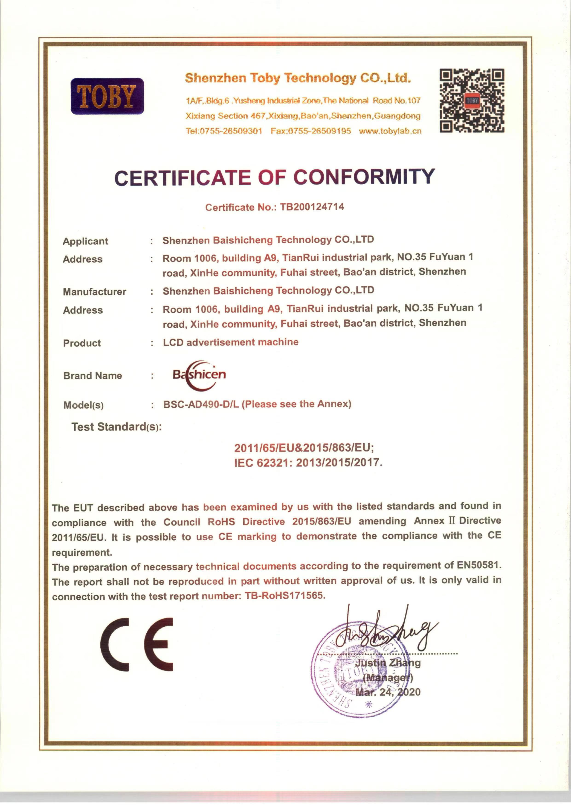
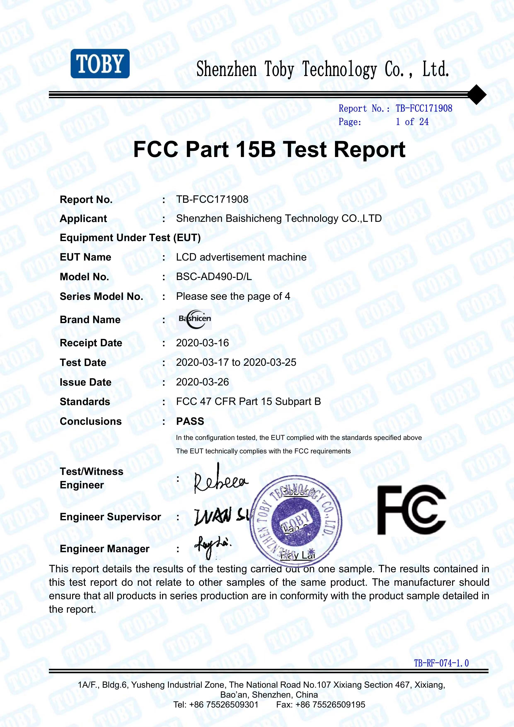

Company Profile
Introduction
We founded in 2014, BAISHICEN is a national standard global LED&LCD display manufacturer, located in Shenzhen, China. We produce integrative, intelligent and high-definition display, including LED&LCD.
Our good technical team provides sophisticated techniques with advanced equipment to ensure the very high quality with our products. Moreover, as a display manufacturer, the outstanding displays get the coginition with certificates of ISO9001, ISO14001, RoHS, CCC, FCC, TUV, BIS with a year free warranty.
BAISHICEN devote to offer clients prompt service and rapid delivery. We had worked with 20 more contries around the world, such as U.S, U.K, Singapore, Germany and so on.

Slide 4
BUSINESS AREA
Indoor LED Display(4K/HD/1080P)
Splicing LCD for different inch(55’’/49’’/46’’,ect.)
Outdoor LED Display(High Brightness Billborad)
LED&LCD
Sercurity Monitoring LCD
customized-available
Flexible LED Display(Bendable/DIY)
Commericial / Family Use HD LCD TV

Slide 5

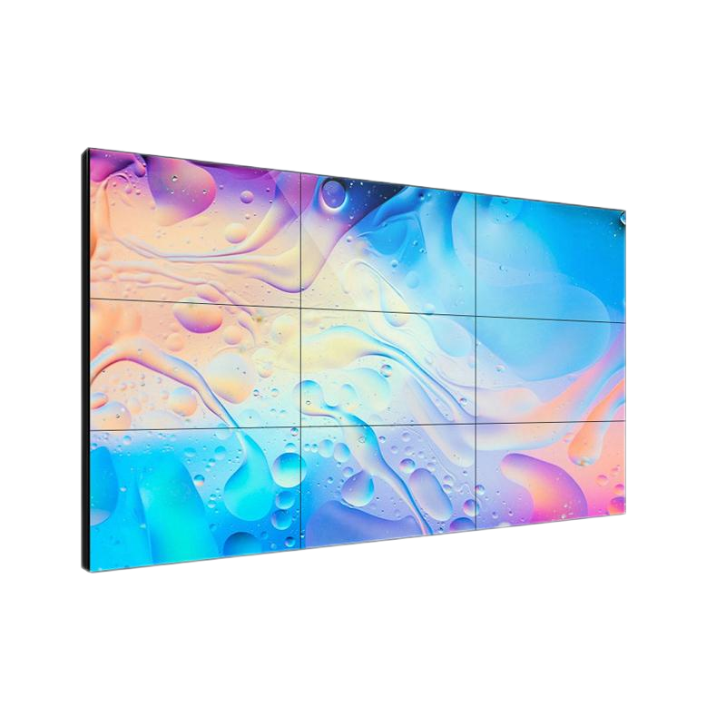
Liquid crystal splicing screen
Ultra narrow seam perfect display
1. Ultra-narrow frame, perfect display
2. Automatic color adjustment
3.178 ° wide viewing angle, wide view
4. Intelligent temperature control system
Model/parameter | BSC-PL4611CZB | BSC-46PL-PJN | BSC-46PS-PJN | BSC-PL49CZB1 | BSC-55PD-PJN | BSC-PL55CZB2 | BSC-PL55CZB1 | BSC-65PS-PJN
Panel size | 46 | 46 | 46 | 49 | 55 | 55 | 55 | 65
Splicing gap(mm) | 0.88 | 1.7 | 3.5 | 3.5 | 0.88 | 1.8 | 3.5 | 3.5
Resolution | 1920x1080 | 1920x1080 | 1920x1080 | 1920x1080 | 1920x1080 | 1920x1080 | 1920x1080 | 3840*2160
Rightness | 500cd/m²
Contrast | 4000∶1
Response time | 8ms
Standard color | 8bit-16.7M
Visible angle | 178°（CR≥10）
Input interface | HDMI*1/DVI1/VGA*1/CVBS*1/USB*1
Communication Interface | RS*232 to RJ45
Whole machine size(mm) | 1020.0251x574.61 | 1020.0251x574.61 | 1021.98x576.57 | 1077.6x607.8 | 1210.51x681.22 | 1211.4x682.2 | 1213.4.4x684.2 | 1432.7.4x807.82
Weight (KG) | 20 | 20 | 20 | 21 | 26.5 | 26.5 | 26.5 | 26.5
Power Supply | 100-240VAC,50/60Hz
Maximum power consumption | 150W

Slide 6
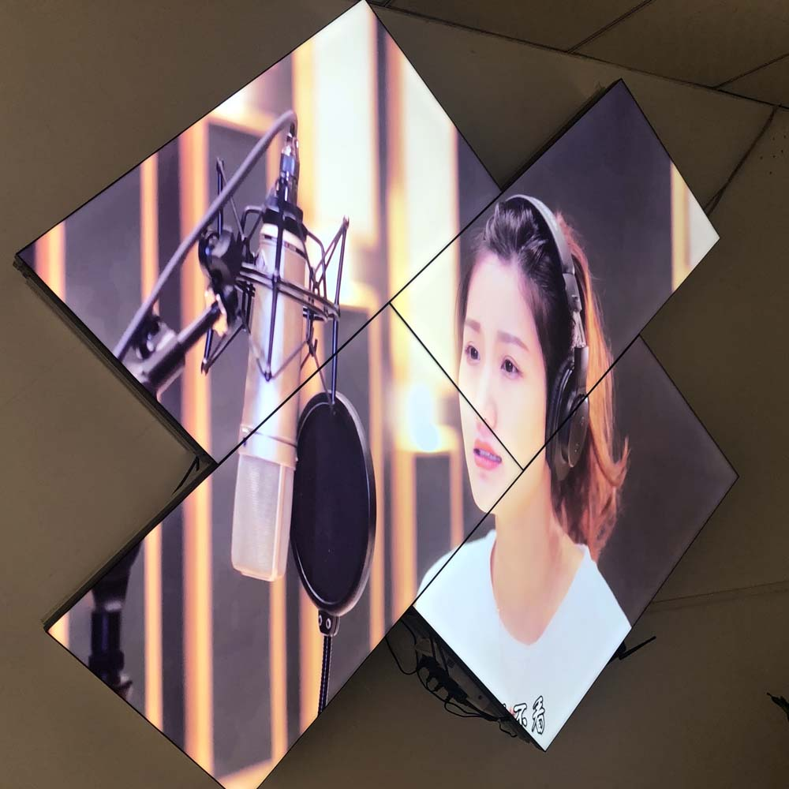
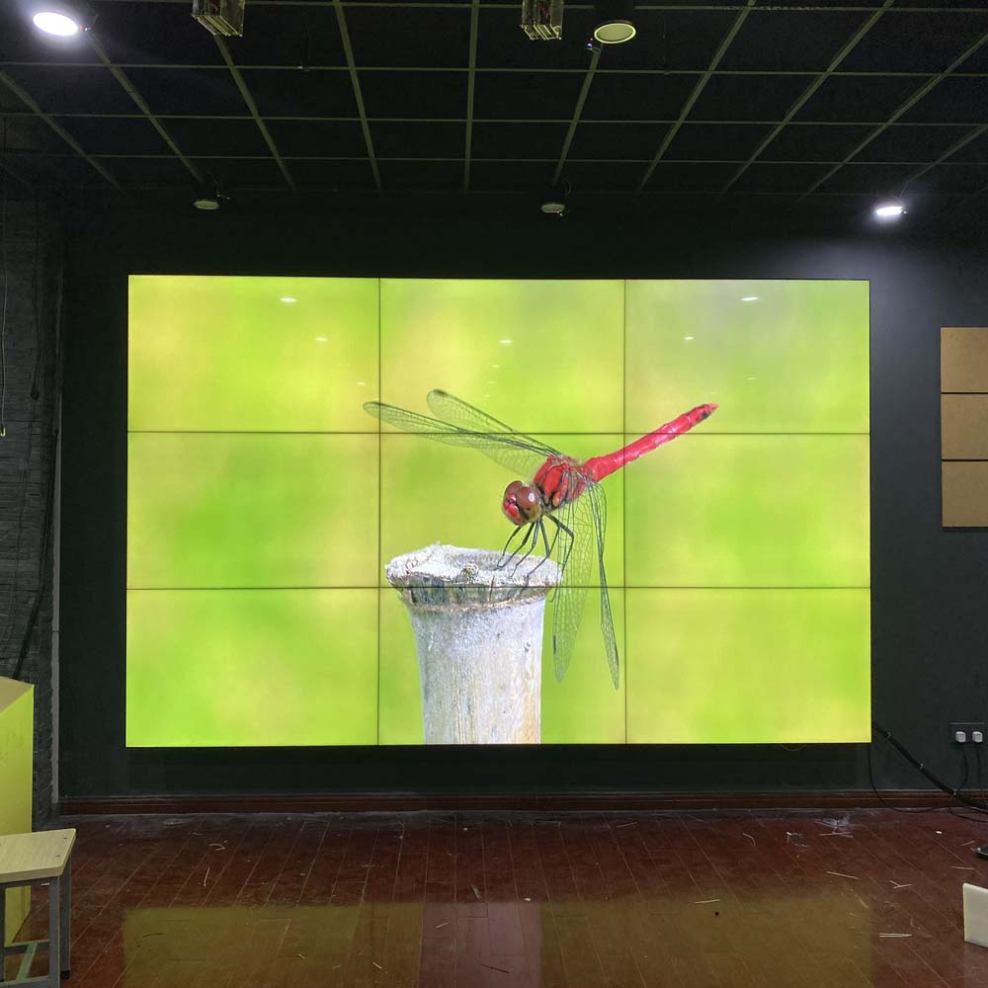
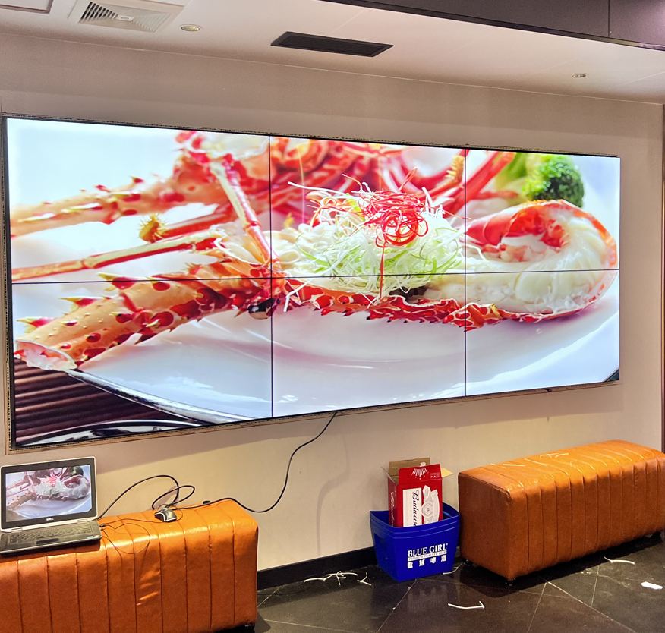
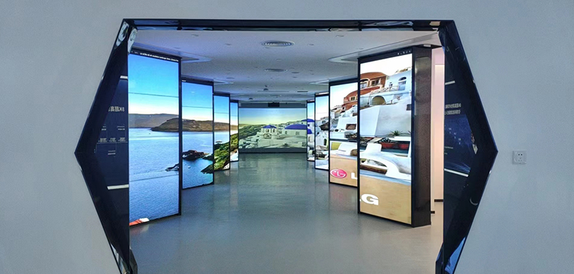
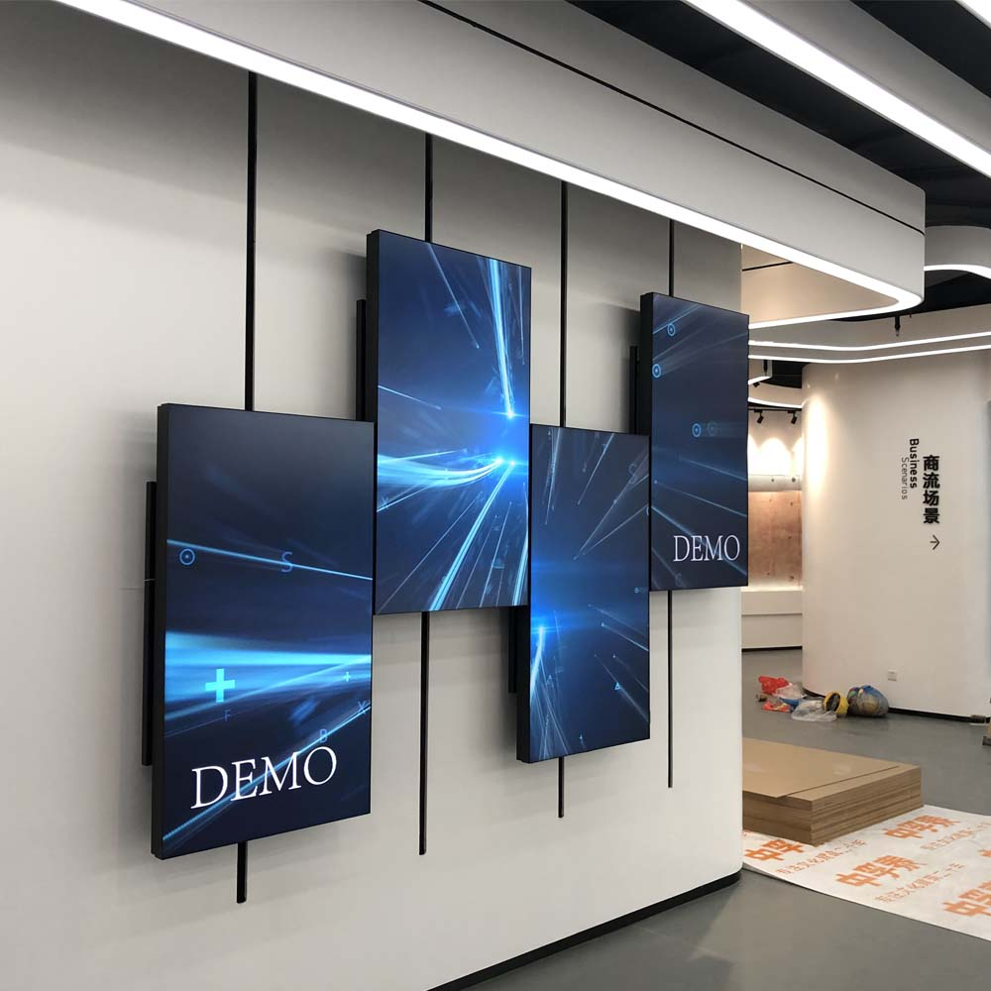
case

Slide 7
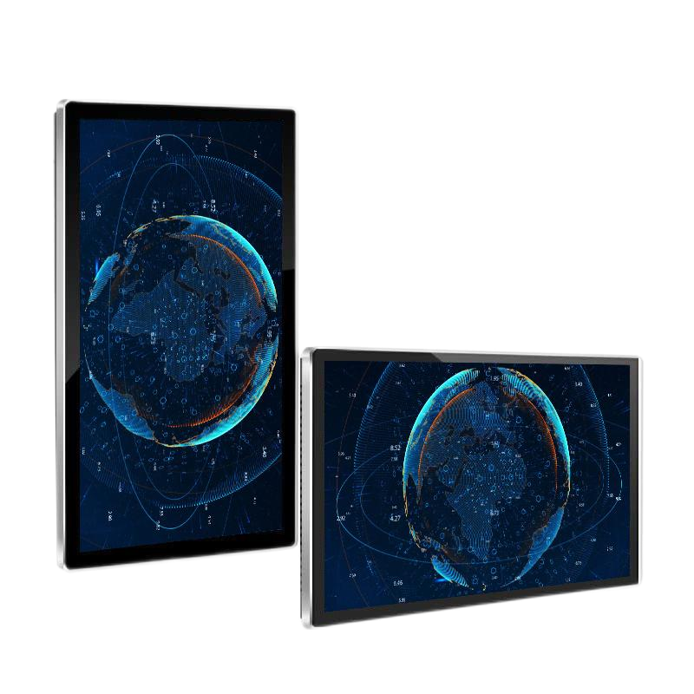
Wall-mounted advertising machine
Ultra-thin advertising machine
1. Ultra-thin body, pure aluminum alloy frame explosion-proof tempered glass
2. Intelligent switching of horizontal and vertical screens
3. Full support for mainstream video/audio/picture formats
4. Multi-region display, free choice
Model/parameter | BSC-P4300 | BSC-P4900 | BSC-P5500 | BSC-P6500 | BSC-P7500 | BSC-P8600
Screen Size（inch） | 43 | 49 | 55 | 65 | 75 | 86
Panel size(mm) | 986x574 | 1119x649 | 1255X725 | 1474x849 | 1693x977 | 1953X1125
Aspect Ratio | 16∶9
Contract Ratio | 1400∶1
View Angle | 178°
CPU | Quad-core Cortex-A17 up to 1.8GHz
GPU | Mali-T760 MP4 @600MHz
RAM | 2GB DDR3
ROM | 16GB NAND Flash
Operating system | Android 7.1/ 9.0
USB | USB 2.0 x 2
Wi-Fi | 802.11b/g/n

Slide 8
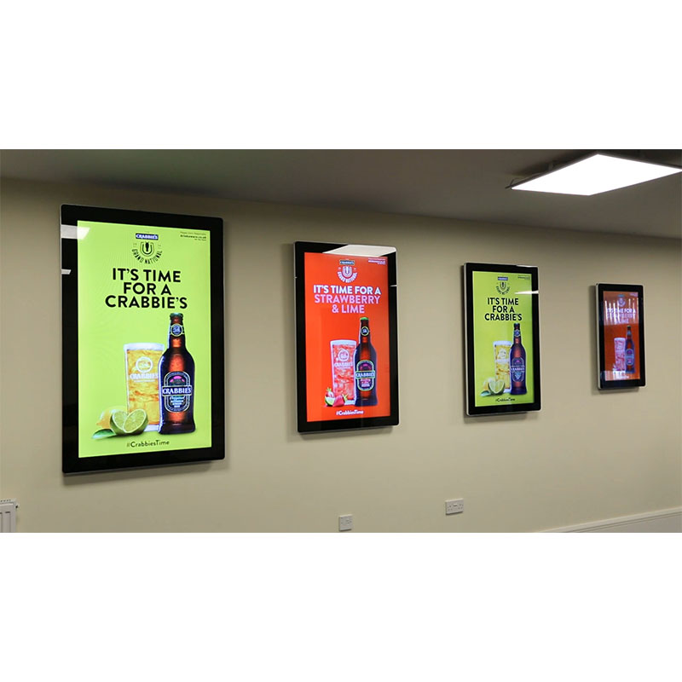
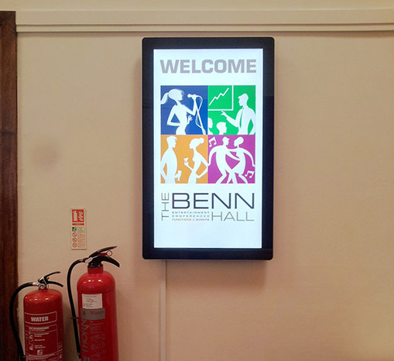
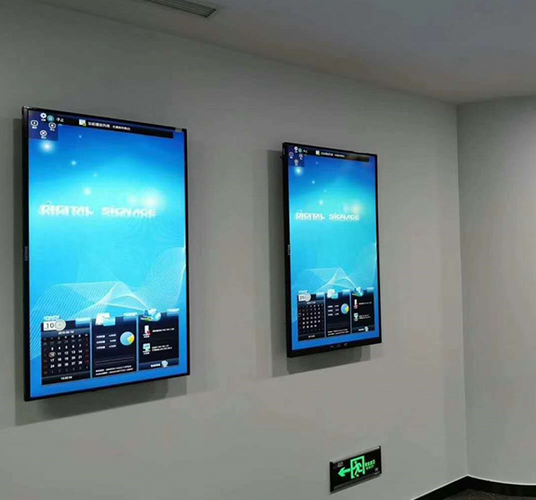
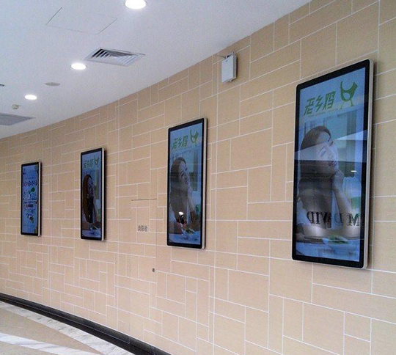
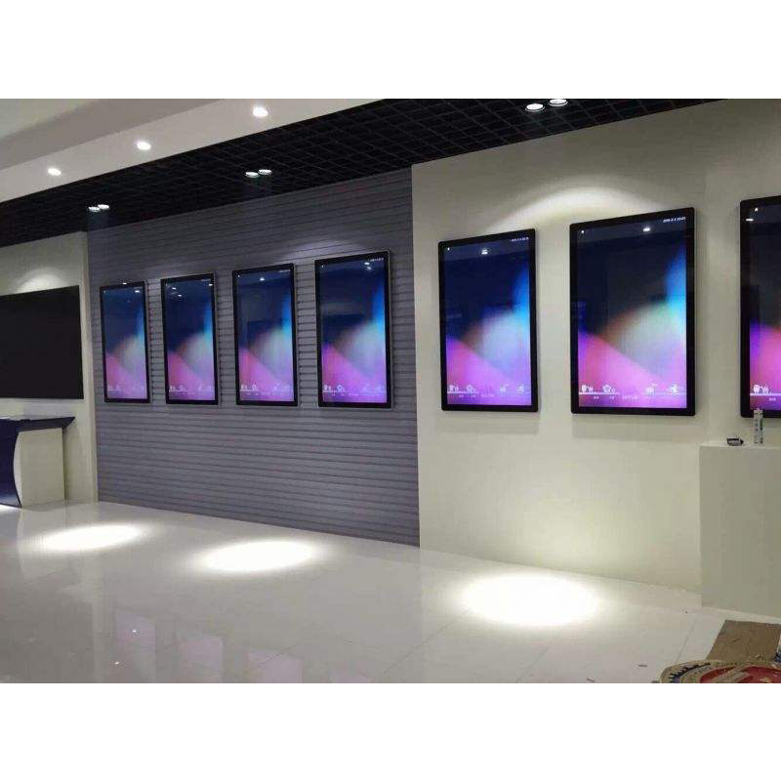
case

Slide 9
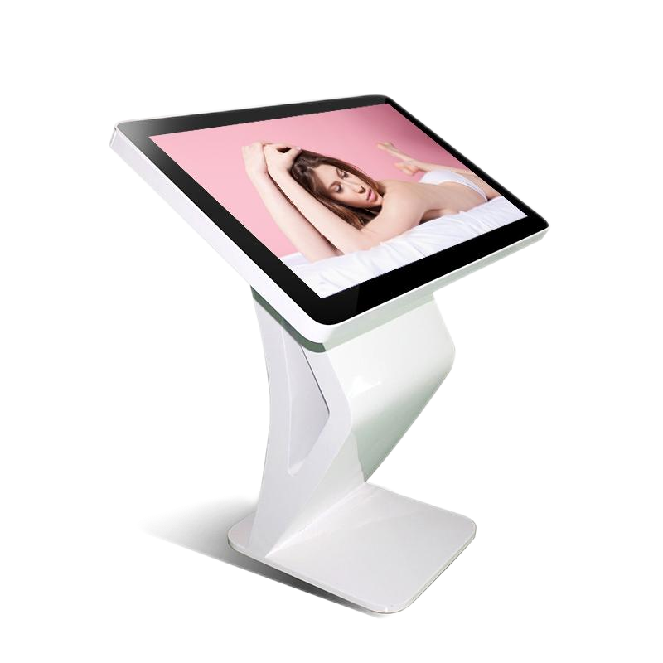
Touch integrated machine
makes interaction more flexible
1. Fully support mainstream audio/Image formats
2. Easy maintenance and management.
3. Full Channel annotation
4.Windows system, stable and smooth
Model/parameter | BSC-S3200 | BSC-S4300 | BSC-S4900 | BSC-S5500 | BSC-S6500 | BSC-S7500 | BSC-S8600 | BSC-S9800
Screen Size（inch） | 32 | 43 | 49 | 55 | 65 | 75 | 86 | 98
Whole machine size（mm） | 770.78x470.32 | 1010.8x599 | 1140.9x671.9 | 1284.9x755.9 | 1504x882.24 | 1750.68x1054.7 | 1981x1177 | 1981x1177
Resolution | 1920*1080（16：9） |  |  |  |  | 3840*2160（16：9）
Angle | 178/178/178/178(L/R/U/D)
Backlight | Led backlight
Brightness | 400cd/m2 | 360cd/m2 | 360cd/m2 | 360cd/m2 | 360cd/m2 | 360cd/m2 | 360cd/m2 | 360cd/m2
Processor | Intel Core i3 | 360cd/m2
Internal storage | 4G DDR31600
Hard disc | 120G high-speed Solid State
Display card | Display card
output interface | HDMI×4,VGA×1,RJ45×1,PCAUDIO×1,MIC×1,
Input interface | HDMI×2,VGA×1,USB×4,YPBPR×1,AVI×2，S-VIDEO×1,
Storage temperature | -40℃~70℃
Working humidity | 10%~90％
Power Input | AC100~240V 50 /60 HZ
Standby power consumption | ≤10W

Slide 10
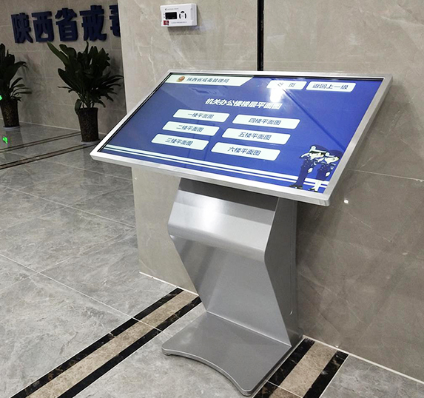
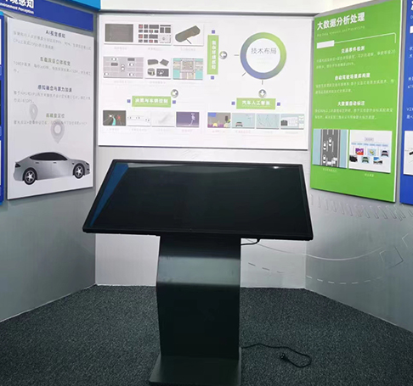
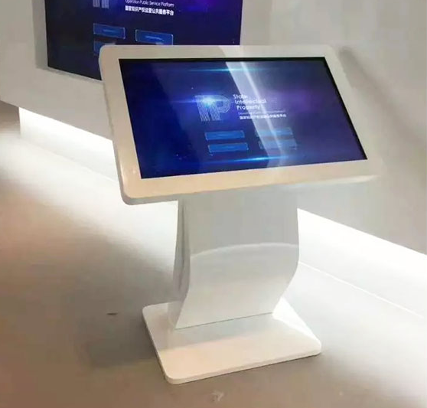
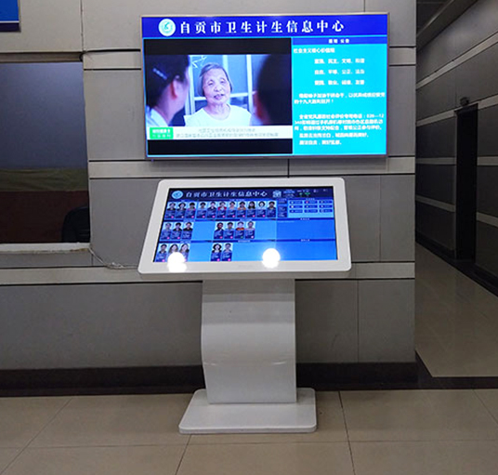
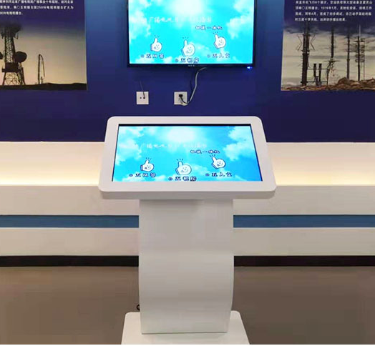
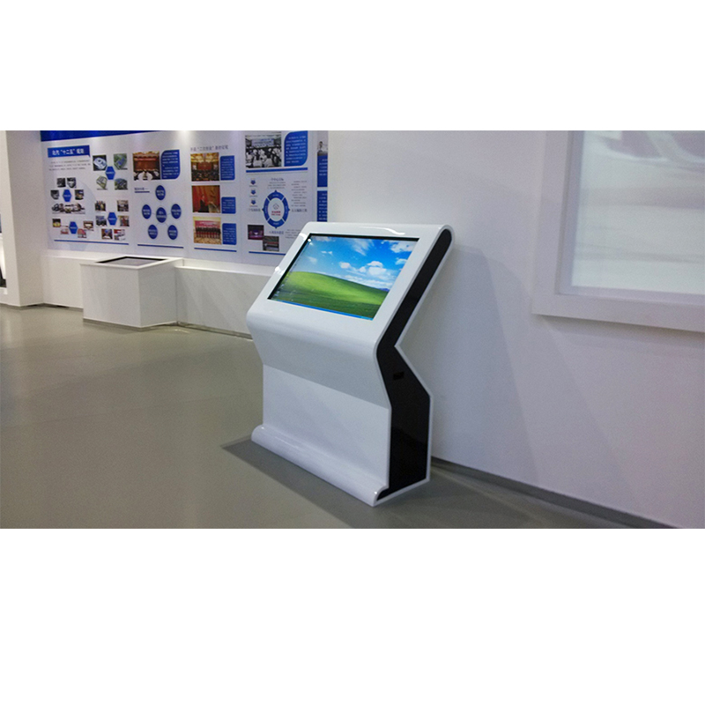
case

Slide 11
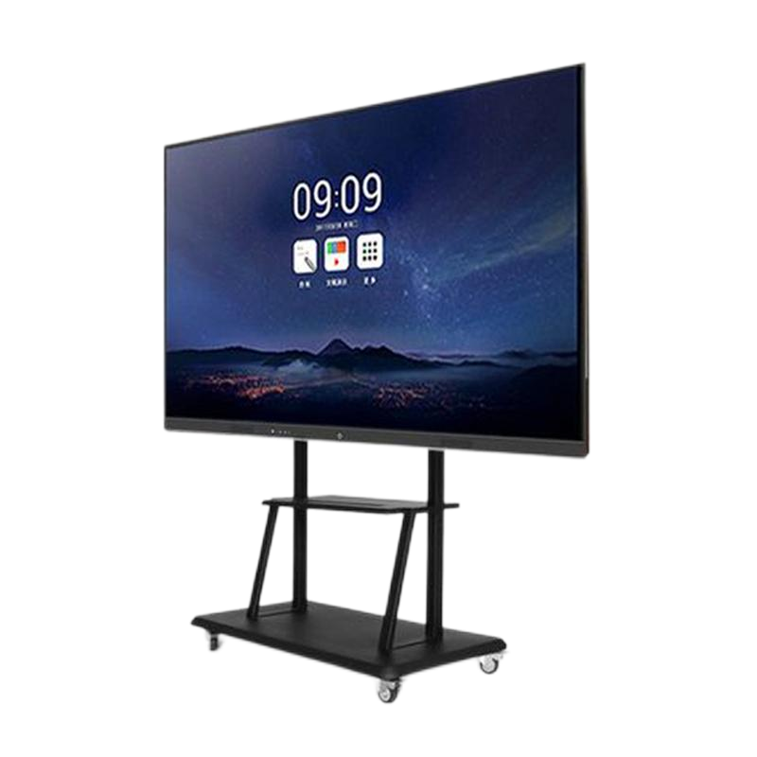
Touch conference integrated machine
Intelligent whiteboard
Model/parameter | BSC-H7500 | BSC-H8500 | BSC-H8600 | BSC-H9800 | BSC-H1100
Screen Size（inch） | 75 | 85 | 86 | 98 | 110
Whole machine size（mm） | 1722*1032 | 1930*1146 | 1964*1168 | 2213*1304 | 2515*1504
Packing size(MM) | 1875*1205*6245 | 2113*1345*250 | 2113*1345*250 | 2425*1532*255 | 2685*1730*280
Net weight of the whole machine includes wall hanging(kg) | 56.5 | 70.5 | 70.5 | 108 | 148
Built-in camera | 800W
Creen ratio | 16∶9
Resolution | 3840x2160
Brightness | 450cd/m²
Contrast | 4000∶01∶00
CPU | ARMA73x2j＋A53x2-1.5GHz
Operation system | Windows7/10 (Optional OPS )&Android 8.0
1. One machine is multi-purpose
from complex to simple.
2. Smart whiteboard, real touch.
3. Intelligent Annotation and smooth writing.
4. Wireless screen projection, sharing interface

Slide 12
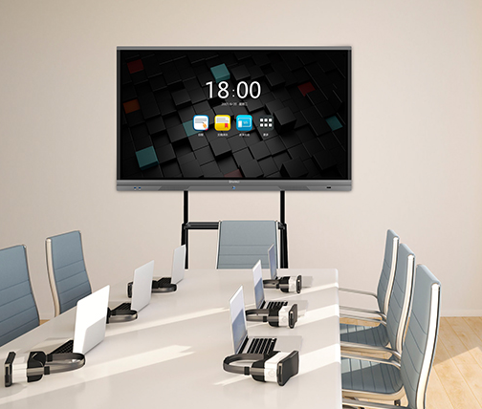
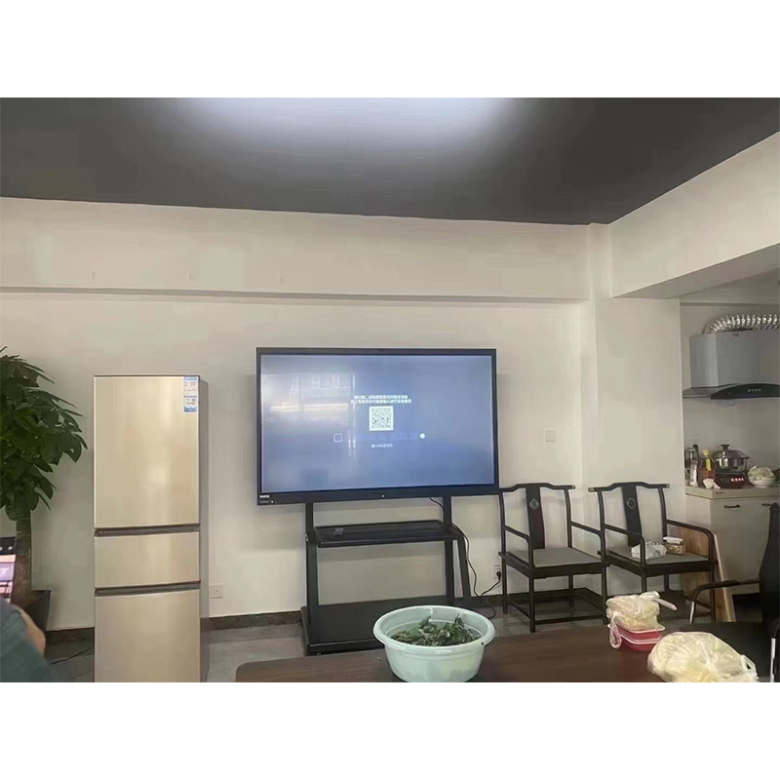
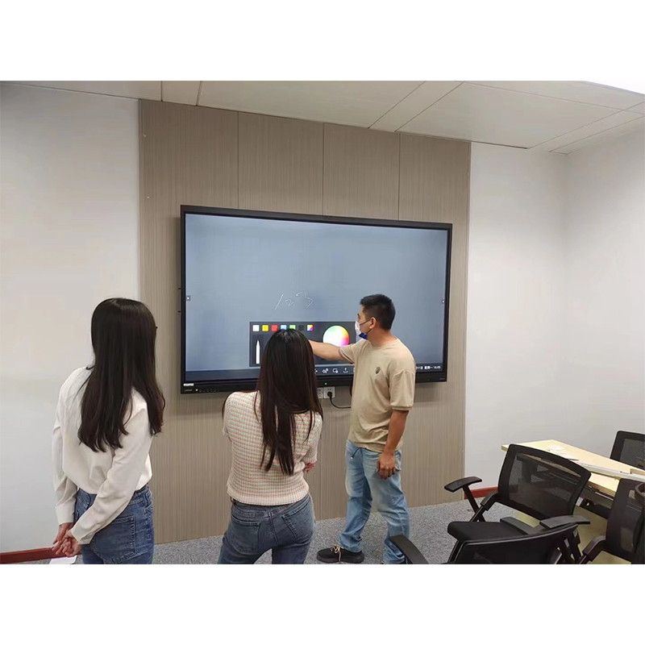
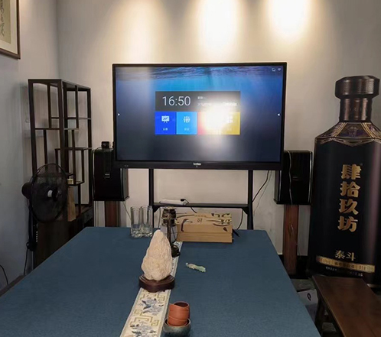
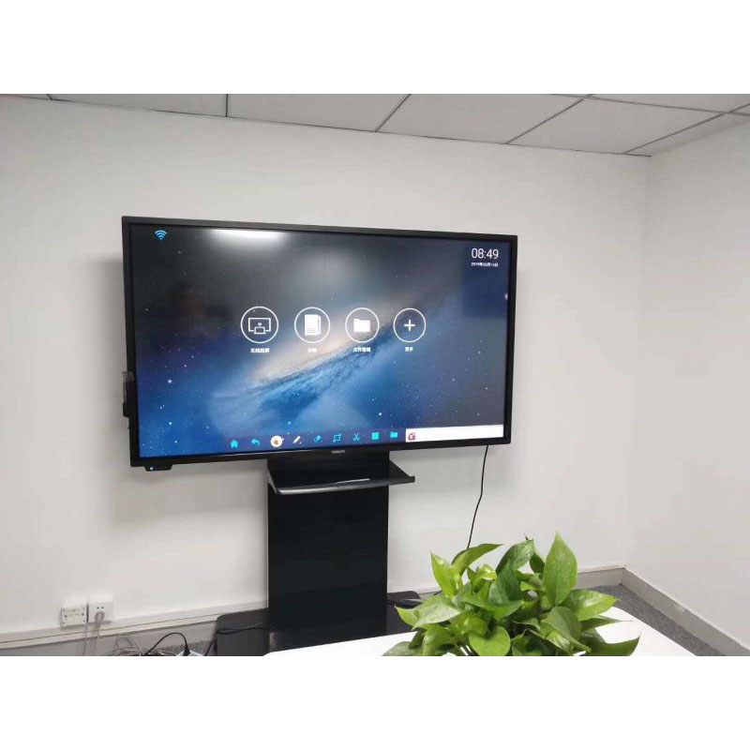
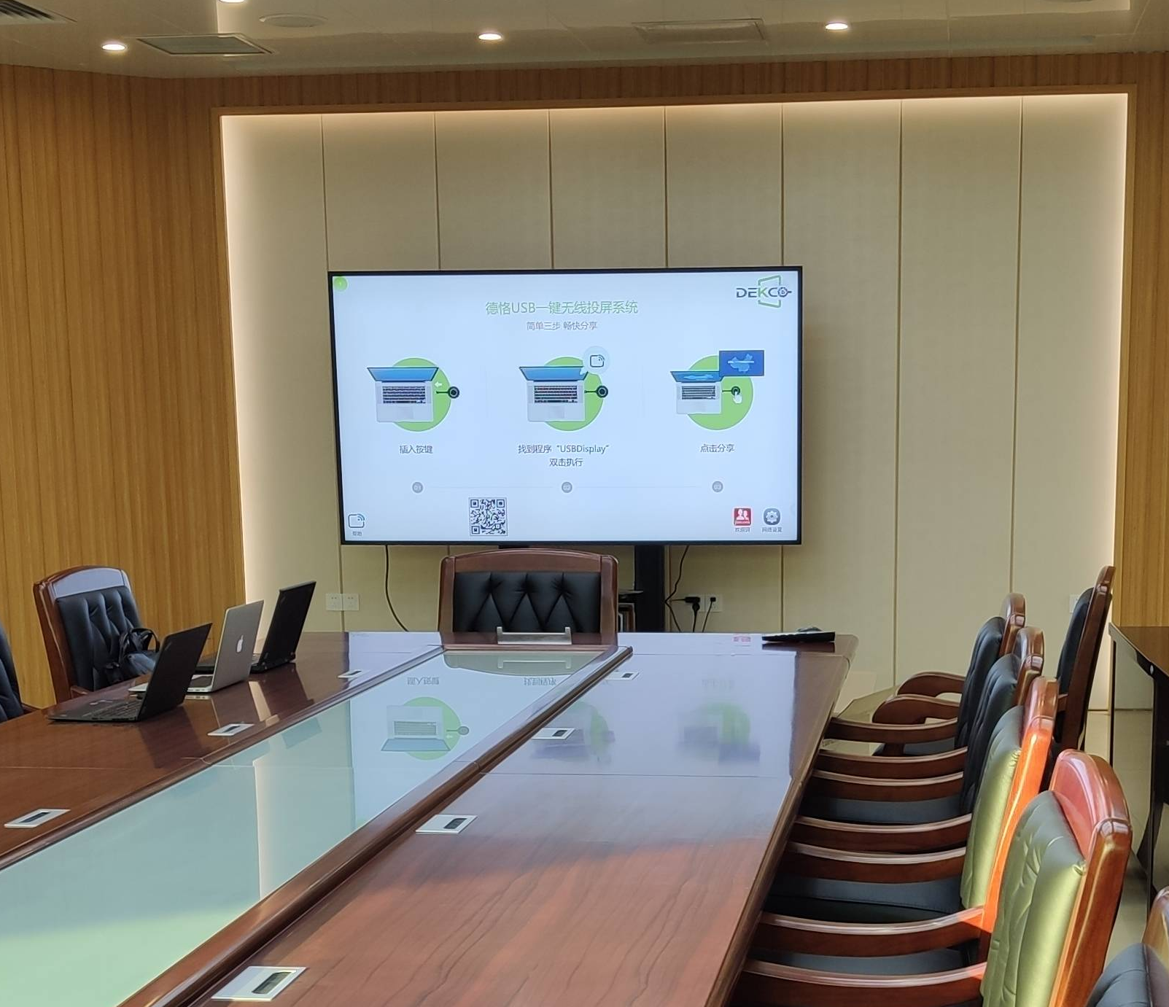
case

Slide 13
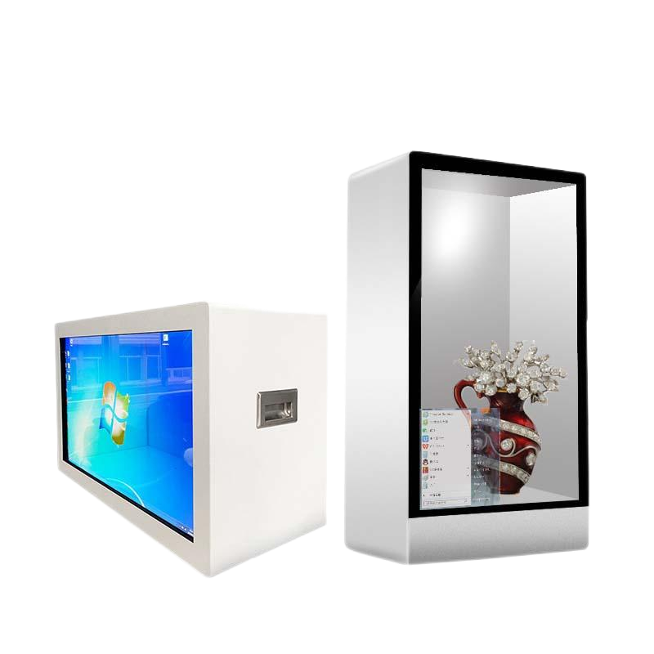
LCD transparent display cabinet
3d stereo effect
1. Intelligent display cabinet, ultra-thin and lightweight
2.3D three-dimensional display Effect
3. Multi-touch, fast response
4. Visual Shock, multi-functional display.
Model/parameter | BSC-G3200 | BSC-G4300 | BSC-G4900 | BSC-G5500 | BSC-G6500 | BSC-G7500 | BSC-G8600
Screen Size（inch） | 32 | 43 | 49 | 55 | 65 | 75 | 86
Panel size（mm） | 698*392 | 941*530 | 1074*603 | 1210*680 | 1428*803 | 1650*928 | 1895*1066
Extemal dimension ofdisplay cabinet （mm） | 920*420*610 | 1140*440*770 | 1320*440*840 | 1435*440*935 | 1680*440*1070 | 1810*440*1088 | 2072*440*1255
Screscaleen | 16∶9
Resolving poower | 1920*1080
Video format | AWMPEG1/MPEG2/MPEG4
Brightness | 450cd/m2
Respones Time | 6ms
Enclosure material | Metal case+transparent screen
Colored systemc | PAL/NTSC/Auto-detecting
Operating system: | Android or Windows or USB plug and play for optional
Voltage Frequency | AC100-240V
Storage temperature | ﹣20-80℃
Storage humidity | 85%no condensation

Slide 14
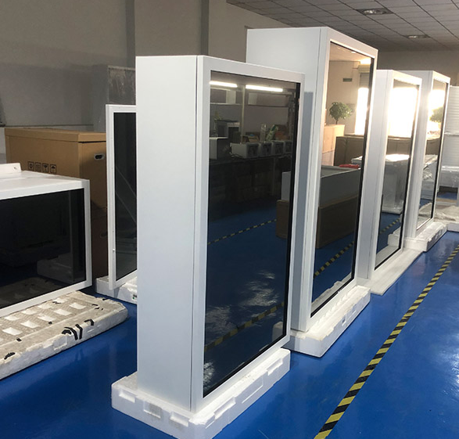
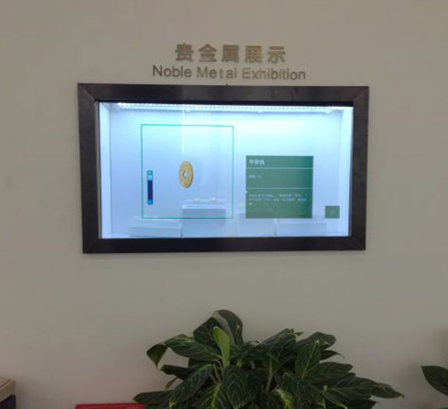
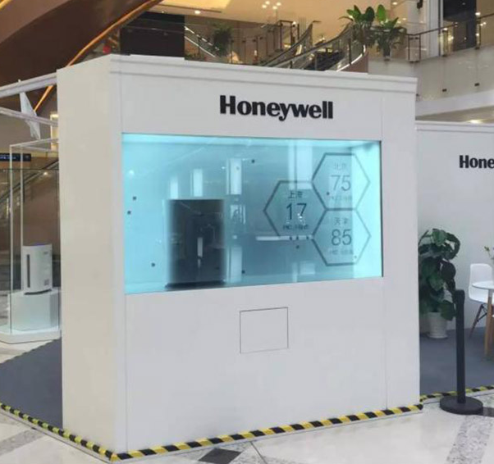
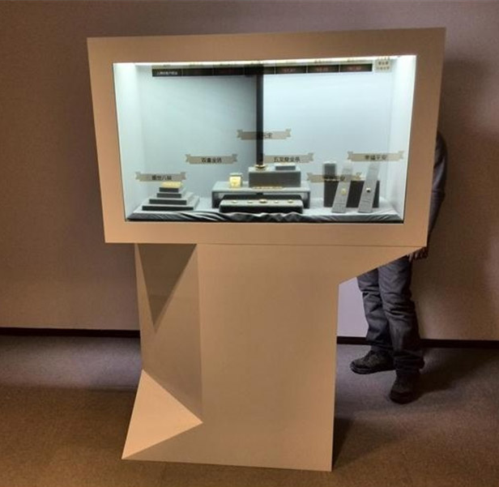
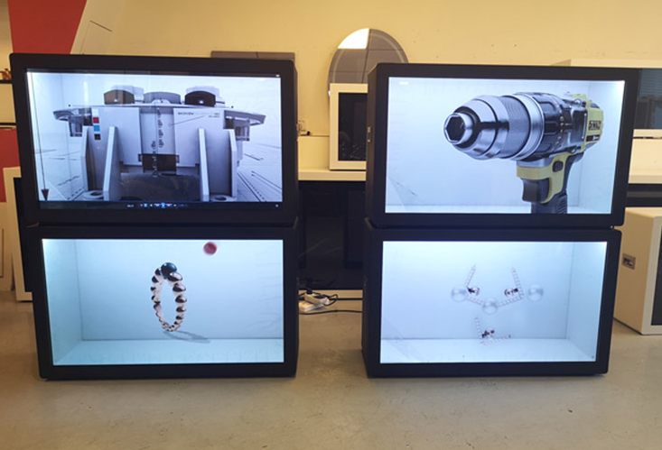
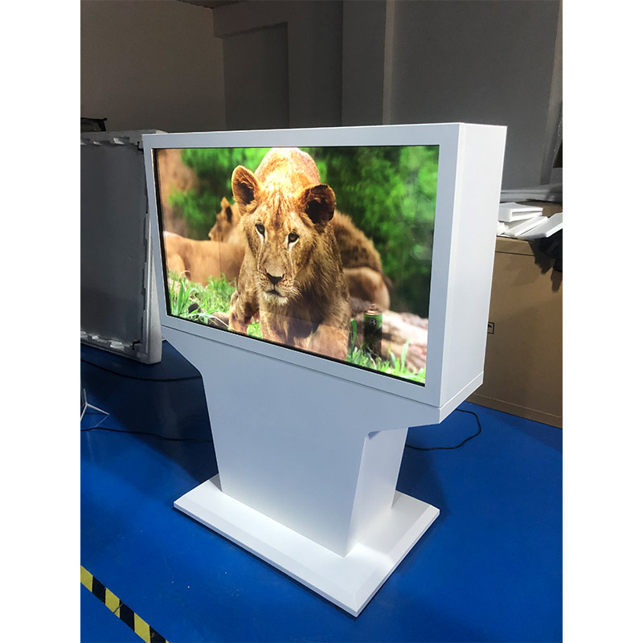
case

Slide 15

Liquid crystal bar screen
Ultra-thin advertising machine
1. Ultra-narrow frame, perfect display
2. Automatic color adjustment
3.178 ° wide viewing angle, wide view
4. Intelligent temperature control system
Model/parameter | BSC-X1640 | BSC-X1910 | BSC-X2130 | BSC-X2400 | BSC-X2800 | BSC-X3550 | BSC-X3770 | BSC-X4080
Screen Size（inch） | 16.4 | 19.4 | 21.3 | 24 | 28 | 35.5 | 37.7 | 40.8
Display Outline Size（mm) | 439.8*106.8 | 506.64*119.37 | 561.36*129.63 | 627.6*142.05 | 627.6*142.05 | 915.6*196.08 | 971.18*206.47 | 1048.1*220.89
Display Area(mm)(W) x (H) | 409.80*76.80 | 476.64*89.37 | 531.36*99.63 | 597.60*112.05 | 698.4*131.0 | 885.6*166.1 | 941.18*176.47 | 1018.08*190.89
Aspect Ratio | <3:1
Resolution | 1920 *360 | 1920 *132 | 1920 *360 | 1920 *158 | 1920 *540 | 1920 *540 | 1920 *360 | 3840 *720
Brightness | 350nits
Contract Ratio | 1200∶1 | 1200∶1 | 1200∶1 | 1200∶1 | 4500∶1 | 4000∶1 | 1400∶1 | 1000∶1
View Angle | 85°
Operating System | Android OS
RAM | 2G
Flash | 16G (NAND Flash)
I/O Port | USB*2/TF card slot/LAN RJ45
Wi-Fi | 802.11b/g/n

Slide 16
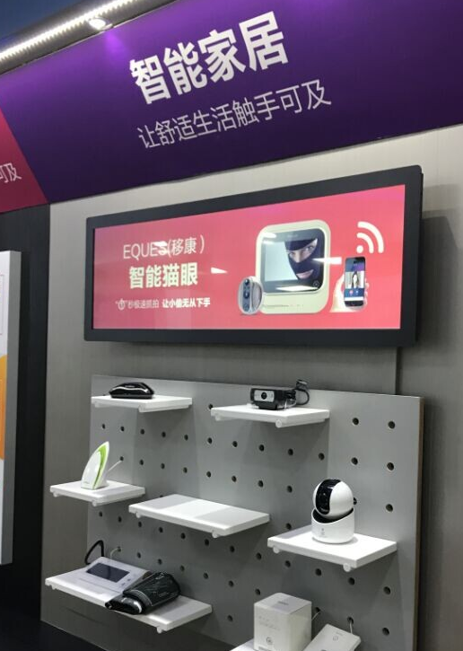
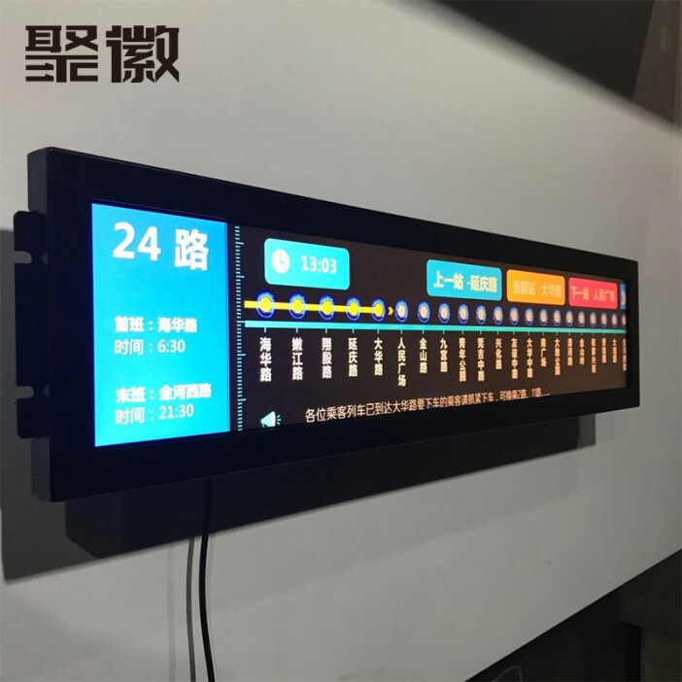
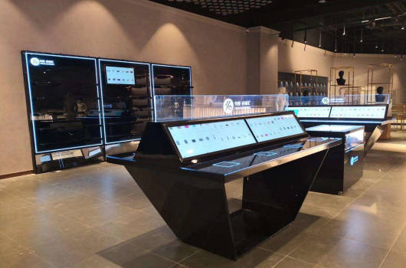
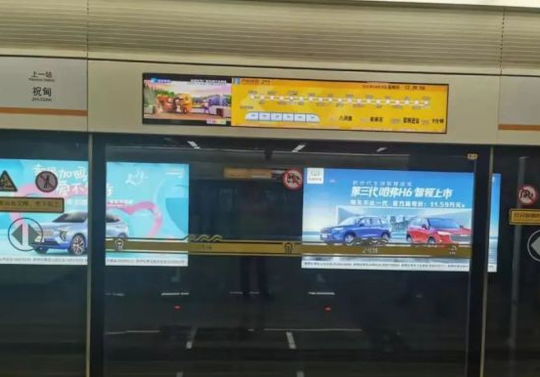
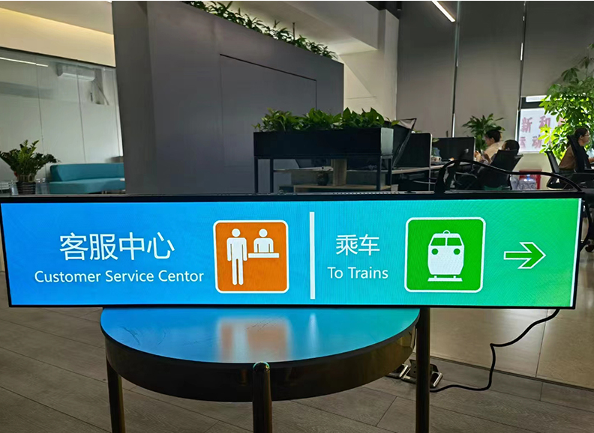
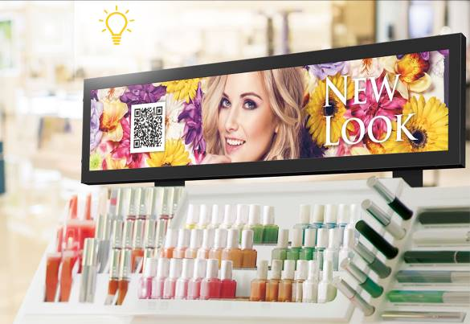
case

Slide 17
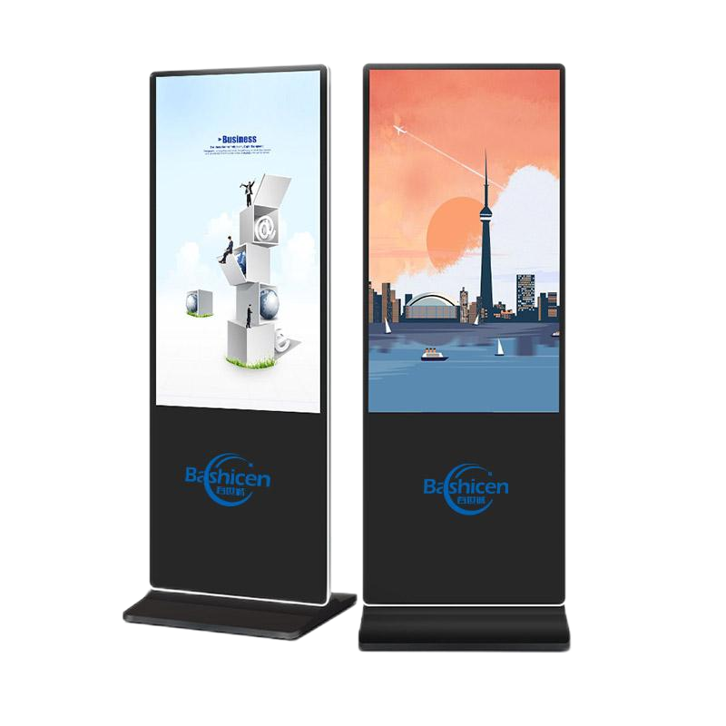
Advertising machine
Ultra-thin advertising machine
1. Ultra-thin body, pure aluminum alloy frame, explosion-proof tempered glass
2. Fully support mainstream video/audio/Format
3. Multi-region Display Free Choice
4. Cloud intelligence release, information release in one step, efficient and time-saving
Model/parameter | BSC-Z4300 | BSC-Z4900 | BSC-Z5500 | BSC-Z6500 | BSC-Z7500 | BSC-Z8600
Screen size(inch) | 43 | 49 | 55 | 65 | 75 | 86
Panel size（mm） | 940x530 | 1074x604 | 1208x679 | 1430x806 | 1650x927 | 1895x1066
Overall size（mm） | 1800x598.8 | 1856.5x672.8 | 1914.7x148.2 | 2000x875 | 2245x1033.6 | 2253x1171
Aspect Ratio | 16:09
Brightness | 450 cd/m²
Contract Ratio | 1400:01:00
Resolution | 1920X1080 | 1920X1080 | 1920X1080 | 3840X2160 | 3840X2160 | 3840X2160
View Angle | 178°
CPU | Quad-core Cortex-A17 up to 1.8GHz
GPU | Mali-T760 MP4 @600MHz
RAM | 2GB DDR3
ROM | 16GB NAND Flash
WI-FI | 802.11 b/g/n
Operating system | Operating system
LAN | 10/100M Ethernet RJ45
USB | USB 2.0 x 2
RJ45 | Ethernet(LAN) x 1

Slide 18
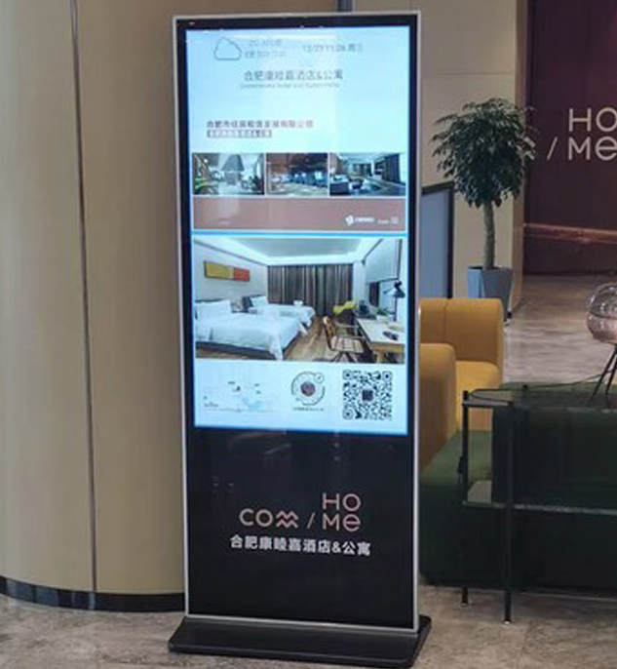
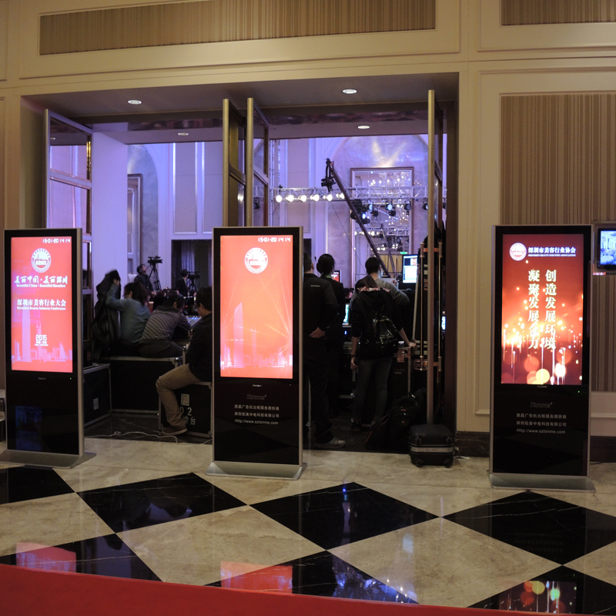




case

Slide 19



Square screen advertisement player
High definition square advertising machine
1. It is environmentally friendly, quiet, reliable and stable.
2. The picture is more natural, and the delicate picture really has no tailing.
3. Used for single-screen information, standard splicing, publishing and displaying.
4. Long service life, 7*24 hours of uninterrupted work, up to more than 60,000 hours.
Model/parameter | BSC-49PL-PJN | Main chip model | RK3288
product size | 44.9inch | Central processing unit (CPU) | Cortex-A17 Quad-Core 1.8GHz
Display size (mm) | 806.4（H）x 806.4（V） | Image processor (GPU) | Mali-T764
the physical resolution | 1280 x 1280 | Running memory (RAM) | 2GB
Point distance (mm) | 0.63（H）x0.63（W） | System memory (ROM) | 8GB(16G optional, maximum support 64GB)
Peak brightness of whole machine | 700cd/㎡±50 | Version | Android 5.0 or above
Dynamic contrast | 4000:01:00 | Appearance color | Black (default)
Viewing angle (square H/V) | 178°/178° | Working temperature | 0-50℃
Display color | 16.7M（8bit） | Working humidity | 10-90%RH (non-condensing)
refresh rate | 50Hz | Storage temperature | -10-60℃
Response time | 8ms | Storage humidity | 10-90%RH (non-condensing)

Slide 20

Outdoor advertising player
Outdoor advertising machine
1. More fluent, impressive and colorful visual effect.
2. Automatically brightness adjustment, make energy-saving come true.
3. Patented waterproof and dustproof, precision structure
Model/parameter | BSC-G3200 | BSC-G4300 | BSC-G4900 | BSC-G5500 | BSC-G6500 | BSC-G7500 | BSC-G8600 | BSC-G9800
Screen Size（inch） | 32 | 43 | 49 | 55 | 65 | 75 | 86 | 98
Panel size（mm） | 697*392 | 941*530mm | 1074*604mm | 1209*680mm | 1428*803mm | 1650*928mm | 1895*1065mm | 2153*1214mm
Media Available | datasheet, Photo, EDA/CAD Models, Other
Specification | Touch Screen, Video Wall, Kiosk
Material | Metal Case + Toughened Glass Panel
Package | Wooden Box
Brightness: | 2000cd/m2
Response Time: | 6ms
Viewing Angle | 178°(H) / 178°(V)
Input Voltage: | 220V
Pixels: | 6mm
Networking way | Internet port, wifi, (optional for 5G/4G networking)

Slide 21






case

